Slide 1
4. Debugging

Slide 2

https://quotefancy.com/quote/3753413/IEEE-Computer-Society-Software-and-cathedrals-are-much-the-same-first-we-build-them-then

Slide 3
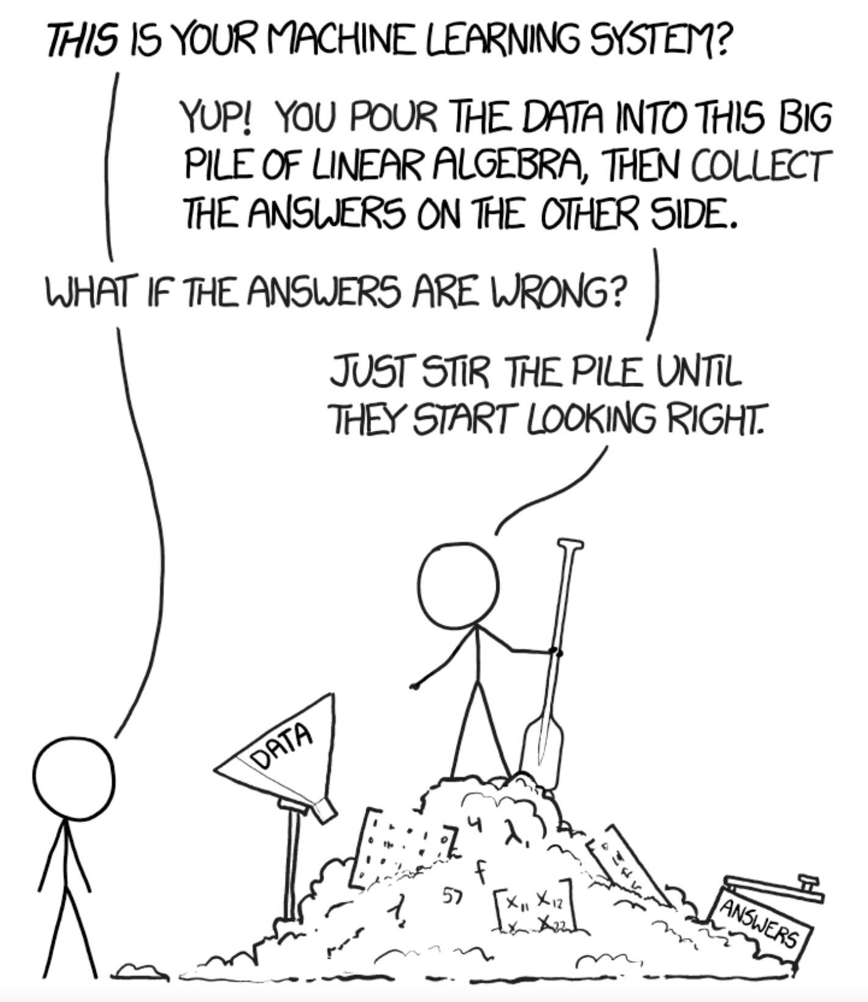
Software debugging is painful
Machine learning debugging can be even more painful!
https://xkcd.com/1838/

Slide 4
Software Engineering Machine Learning
development is ‘smoother’ and more predictable
fewer sources of errors
development is less predictable and needs ‘tweaking’ different components
more sources of error than typical programming:
wrong architecture
wrong data
wrong hyperparameters

Slide 5
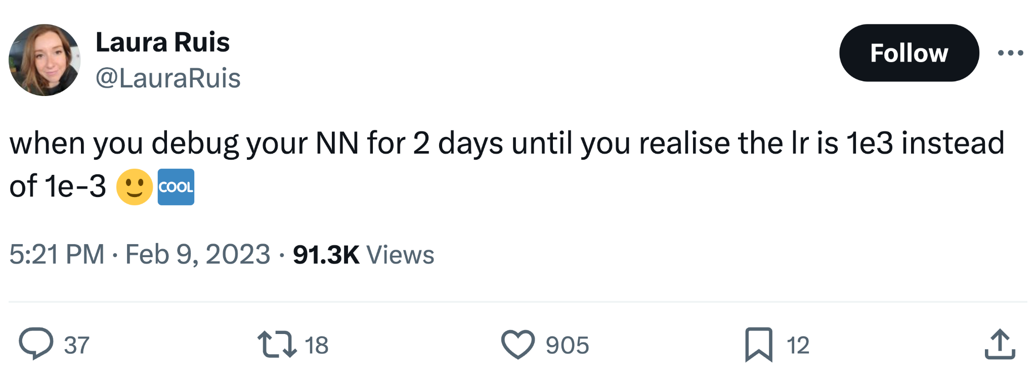
Machine Learning bugs

Slide 6
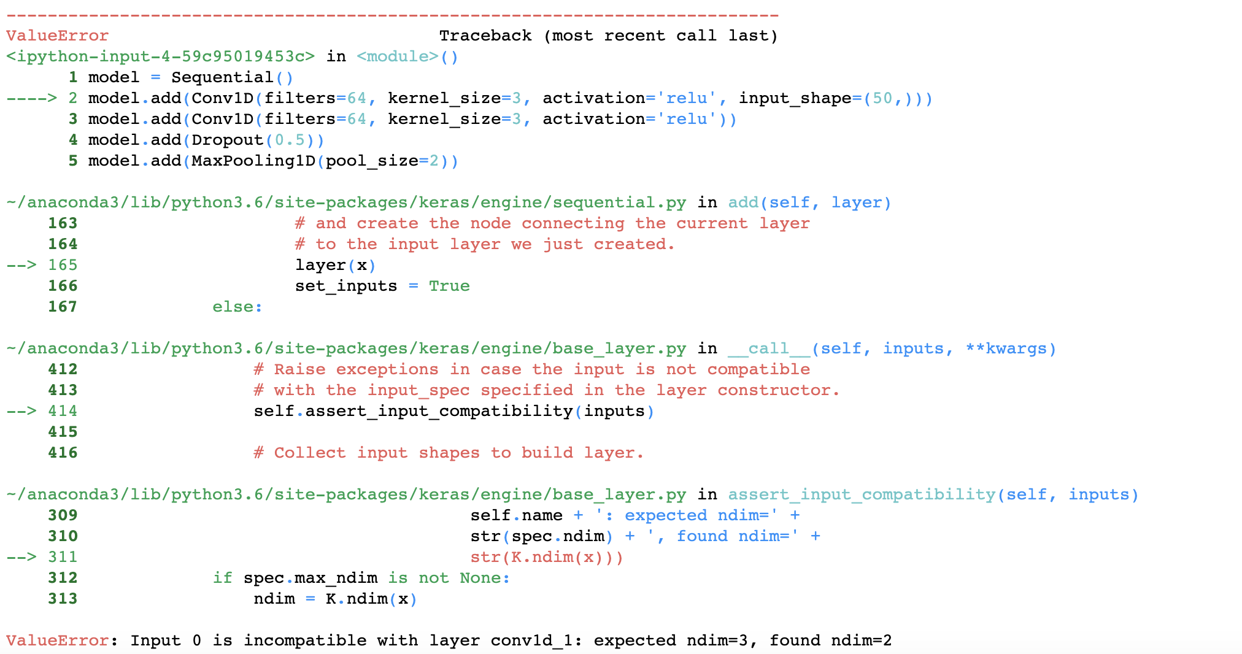
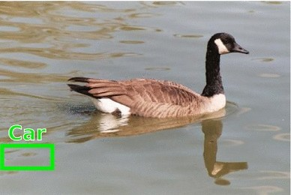
Machine Learning bugs
syntactic
functional

Slide 7
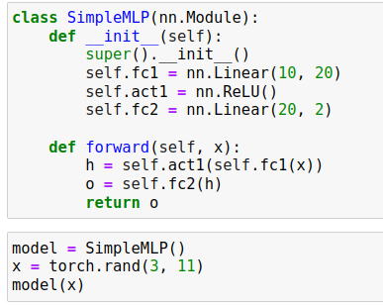
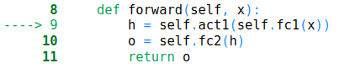
Wrong tensor shape
one of the most common errors is when the tensor shape is incompatible with the current operation
can be easy to figure out when the input data has the wrong shape

Slide 8
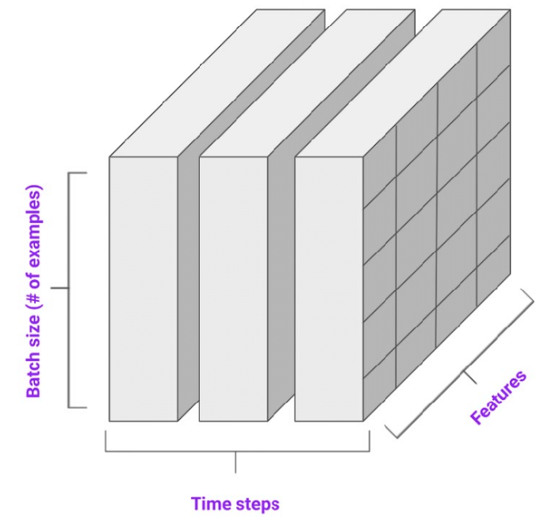

Wrong tensor shape - wrong input shape
typical scenarios:
images:
input Tensor has shape batch x W x H x channels instead of batch x channels x W x H
inputs are greyscale and have batch x W x H
sequential data: input Tensor has shape batch x H x timesteps instead of batch x timesteps x H
Notes:
other examples: network has input shape 3xWxH but receives greyscale image, at test time input is (3 X W X H) instead of (1 x 3 x W x H)

Slide 9
Wrong tensor shape - wrong input shape
scenario: last batch in a dataset may have 1st dimension != batch_size:
why? let’s say batch_size=32
DataLoader loads 32 elements until it exhausts all the dataset elements
if dataset has 3216 elements => last batch has 16 elements
Notes:
conv1d

Slide 10
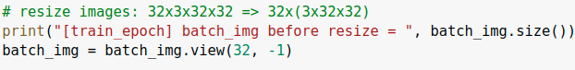
Wrong tensor shape - wrong input shape
scenario: last batch in a dataset may have 1st dimension != batch_size:
if code assumes output size is batch_size, shape errors may appear:
new input size (1536) no longer matches layer size (3x3x32=3072)
Notes:
conv1d

Slide 11
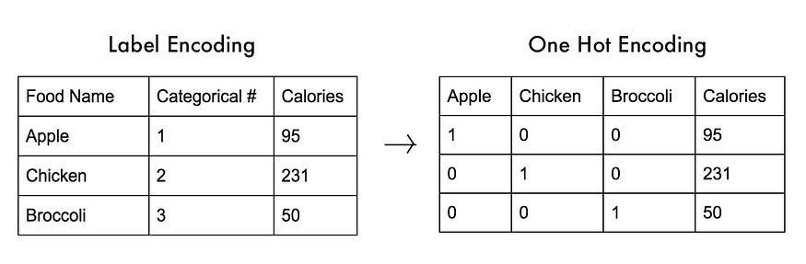
Wrong tensor shape - wrong label shape
labels are one-hot but loss function expects scalar [0, num_classes-1]
source: https://www.thetalkingmachines.com/article/beginners-guide-debugging-tensorflow-models
Notes:
conv1d

Slide 12
Wrong tensor shape - wrong output shape
output doesn’t conform to shape expected by loss function
documentation snippet from CrossEntropyLoss in Pytorch
Notes:
conv1d

Slide 13

Wrong tensor shape - wrong output shape
typical scenarios:
sequential data:
if each timestep is classified into C classes
output for CrossEntropyLoss should be batch x C x timesteps, not batch x timesteps x C
semantic segmentation:
C classes
output for CrossEntropyLoss should be ?
Notes:
conv1d

Slide 14
Wrong tensor shape - wrong output shape
typical scenarios:
sequential data:
if each timestep is classified into C classes
output for CrossEntropyLoss should be batch x C x timesteps, not batch x timesteps x C
semantic segmentation:
C classes
output for CrossEntropyLoss should be batch x C x H x W
Notes:
conv1d

Slide 15
Wrong tensor shape - intermediate ops
other shape mismatches may happen during feedforward:
tensors are manipulated using different ops (slice, concat, max, reshape etc.), but wrong arguments are called => the resulting tensor shape no longer matches with the next layer

Slide 16
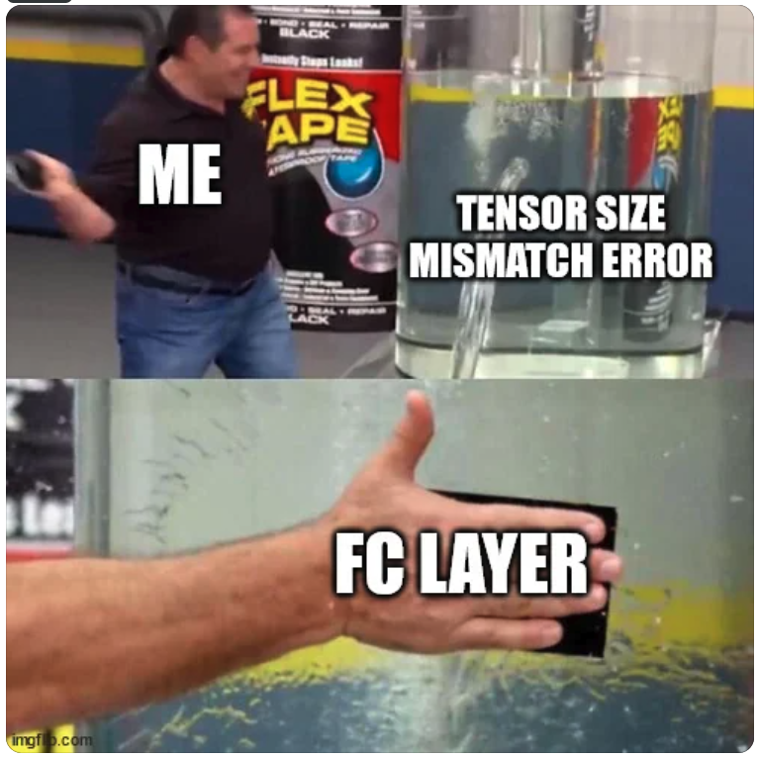
Wrong tensor shape - intermediate ops

Slide 17
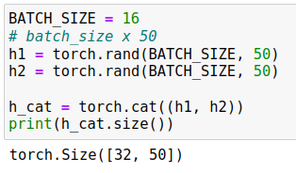

Wrong tensor shape - intermediate ops
scenario: concatenating two tensors on the wrong dimension
cat function concatenates on dim=0 by default!

Slide 18
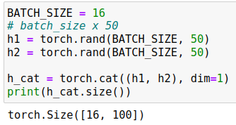
Wrong tensor shape - intermediate ops
scenario: concatenating two tensors on the wrong dimension
good practice: specify dimensions explicitly whenever possible (dim argument)
cat function concatenates on dim=0 by default!
the two inputs are correctly concatenated
Notes:
other example: softmax over wrong dimension when predicting pixelwise value

Slide 19
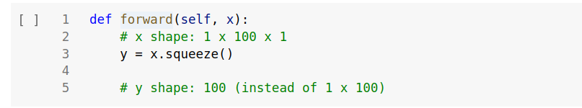
Wrong tensor shape - intermediate ops
scenario:
tensor has batch_size=1 and some other dimension=1
torch.squeeze() removes all dimensions of 1
good practice: explicitly specify squeeze dimensions (dim argument)
Notes:
other example: softmax over wrong dimension when predicting pixelwise value

Slide 20
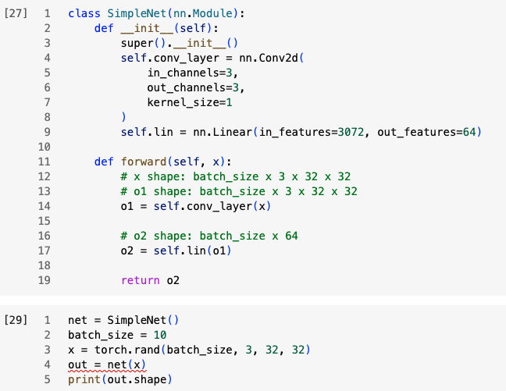

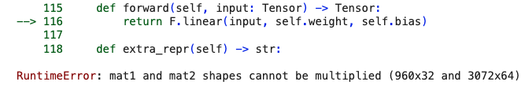
Wrong tensor shape - intermediate ops
scenario:
linear layer after conv2d layer
linear expects input=3x32x32=3072
linear layer
Notes:
other example: softmax over wrong dimension when predicting pixelwise value

Slide 21
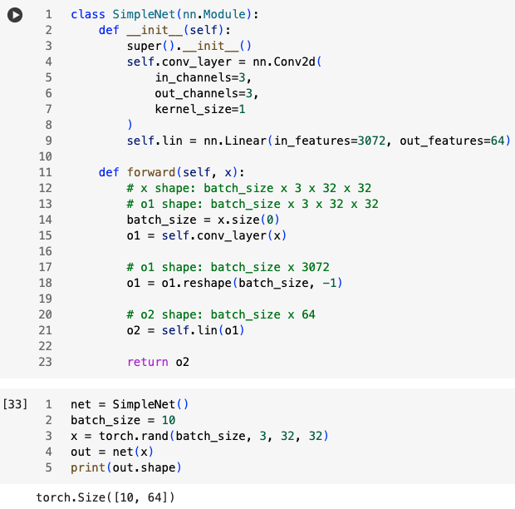
Wrong tensor shape - intermediate ops
scenario:
linear layer after conv2d layer
linear expects input=3x32x32=3072
reshape input
Notes:
other example: softmax over wrong dimension when predicting pixelwise value

Slide 22
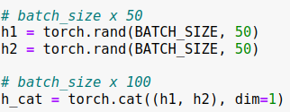
Wrong tensor shape - recap
good practices:
write down tensor shapes after each operation, this will make debugging shape issues easier
Notes:
conv1d

Slide 23
Wrong tensor shape - recap
good practices:
write down tensor shapes after each operation, this will make debugging shape issues easier
carefully read Pytorch documentation for layers (linear, conv2d etc), operations (concat, reshape, etc.) and loss functions
Notes:
conv1d

Slide 24
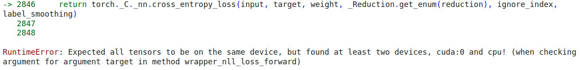
Wrong tensor device
Tensors must be on the same device to perform most operations (no cpu<->cuda or cuda:i<->cuda:j allowed)

Slide 25
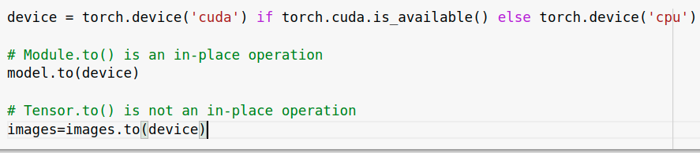
Wrong tensor device
typical scenarios:
model was moved to GPU but input data is still on CPU due to .to() operation
model was loaded from a checkpoint but we forgot to move it to GPU
forgot to move labels to GPU

Slide 26
Wrong tensor device
tips:
write device agnostic code to easily switch between the two
make sure model, inputs and labels are stored on the same device
Notes:
CUDA memory errors

Slide 27
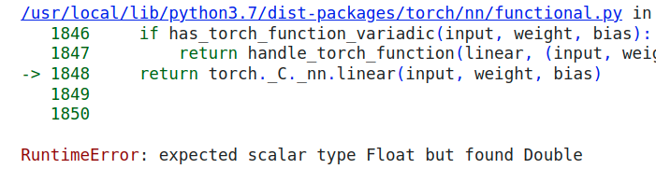
Wrong tensor type
PyTorch ops expect certain Tensor types

Slide 28
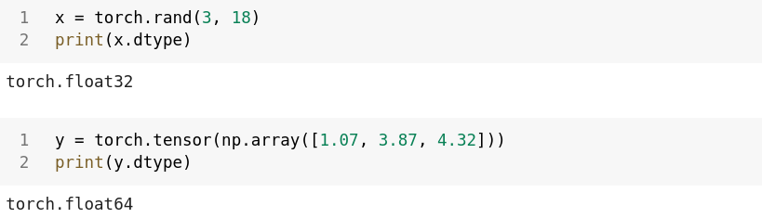
Wrong tensor type
input data and network mismatch:
parameters in torch.nn layers have type float32 (Float) by default
if the dataset is a NumPy array, it gets converted to Tensors of type float64 (Double), which are incompatible with the layers

Slide 29
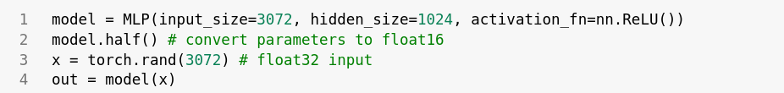
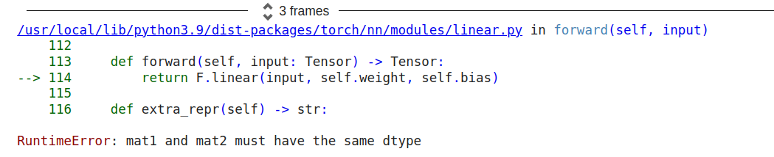
Wrong tensor type
input data and network mismatch:
pretrained model parameters have half-precision (float16)
input is float32

Slide 30
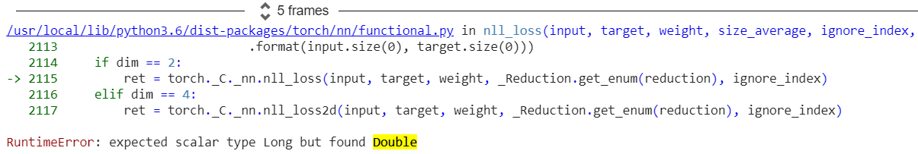
Wrong tensor type
labels and loss mismatch:
labels are read as Float Tensors
we forget to convert them to Long Tensors, required by CrossEntropyLoss

Slide 31
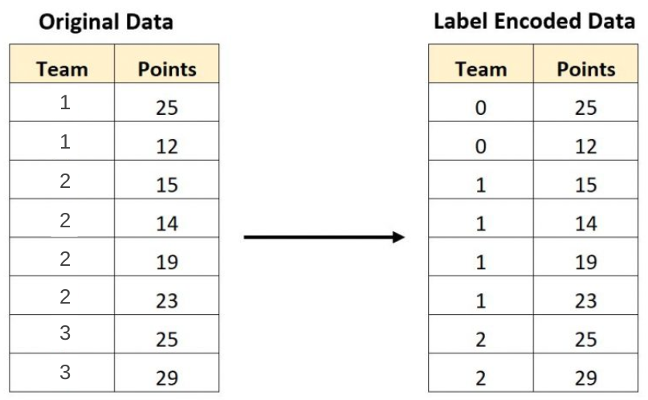
Wrong tensor range
labels are stored as {1,2,...,C} instead of {0,1,...,C-1}
this throws an error in the cost function when accessing the score or label with index C (out of range)
Notes:
conv1d

Slide 32

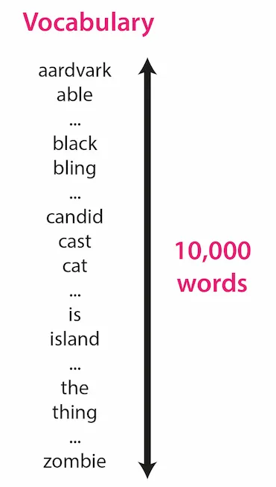
Wrong tensor range
when working with text data, each word has a unique index {0..V-1}
for V = 10000, x[10000] results in an ‘index out of range’ error
source
Notes:
conv1d

Slide 33
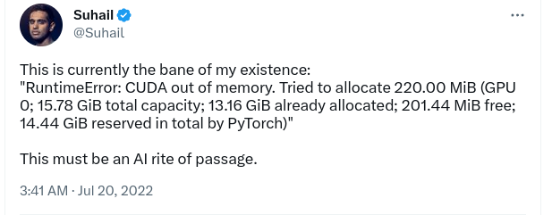
Out of memory errors
Notes:
conv1d

Slide 34
Out of memory errors (2)
causes:
memory inefficiencies or leaks
VRAM limitations:
a 7B model needs 14GB VRAM memory just to store model weights in float16
training all weights requires ~80-100GB VRAM memory => model parallelism
Notes:
conv1d

Slide 35
Out of memory errors - test time
check for memory inefficiencies:
wrap forward code in torch.no_grad(), which disables gradient calculation and reduces memory consumption
if you save outputs (segmentation maps, probabilities) for later inspection, move Tensors to CPU
Notes:
conv1d

Slide 36
Out of memory errors - test time
check for memory inefficiencies:
wrap forward code in torch.no_grad(), which disables gradient calculation and reduces memory consumption
if you save outputs (segmentation maps, probabilities) for later inspection, move Tensors to CPU
reduce model size:
load model in half-precision (FP16)
quantize model (INT8)
Notes:
conv1d

Slide 37
Out of memory errors - test time
check for memory inefficiencies:
wrap forward code in torch.no_grad(), which disables gradient calculation and reduces memory consumption
if you save outputs (segmentation maps, probabilities) for later inspection, move Tensors to CPU
reduce model size:
load model in half-precision (FP16)
quantize model (INT8)
reduce input:
reduce batch size
feed shorter sequences (if working with text/time series etc.)
Notes:
conv1d

Slide 38
Out of memory errors - train time
check for memory leaks (detach loss from computational graph before storing it)
if more GPUs available, model parallelism
reduce model training footprint:
train with mixed precision (float16+float32)
train with parameter-efficient methods (LoRA)
reduce input size:
downsize image / train with shorter sequences
reduce batch size
reduce model size:
use less layers, smaller layer size etc.
Notes:
conv1d

Slide 39
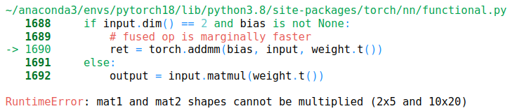
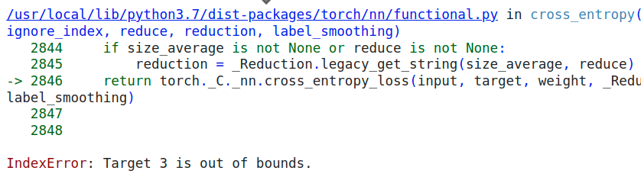
Syntactic Issues - recap
type errors
shape errors
range errors
device errors

Slide 40
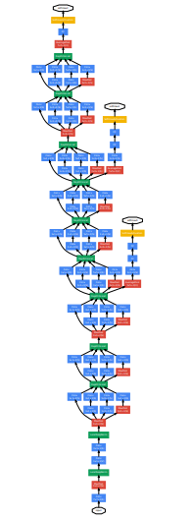


Syntactic Issues - recap
shape errors
type errors
OOM errors
nn layer (float32)
float64
device errors
range errors
x[3]
Inception network
Notes:
GPU Icon source: https://thenounproject.com/icon/gpu-1907650/
CPU Icon source: https://thenounproject.com/icon/cpu-2308475/

Slide 41
Machine Learning bugs
syntactic
functional

Slide 42
Machine Learning functional bugs
neural network trains, but the model’s performance is bad/suboptimal
there are many sources of errors:
logic errors (typos, wrong inputs, wrong labels, incorrect arguments)
bad model hyperparameters
dataset issues

Slide 43
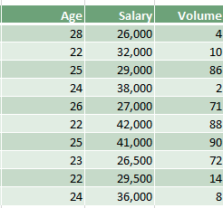
Numerical issues
normalization/standardization is:
missing
computed over the wrong dimension
Notes:
https://www.kdnuggets.com/2020/04/data-transformation-standardization-normalization.html

Slide 44
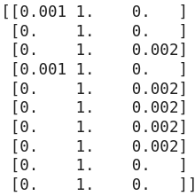

Numerical issues
normalization/standardization is:
missing
computed over the wrong dimension
Notes:
https://www.kdnuggets.com/2020/04/data-transformation-standardization-normalization.html

Slide 45
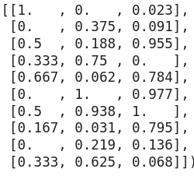
Numerical issues
normalization/standardization is:
missing
computed over the wrong dimension
Notes:
https://www.kdnuggets.com/2020/04/data-transformation-standardization-normalization.html

Slide 46
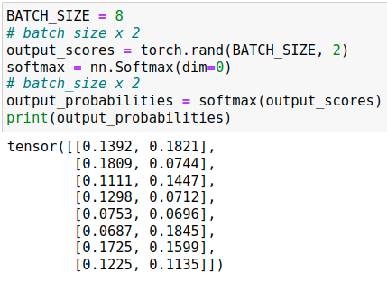
Numerical issues
softmax is:
applied over the wrong dimension
Notes:
conv1d

Slide 47
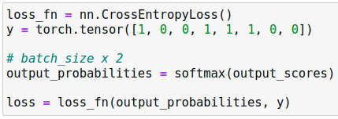
Numerical issues
softmax is:
applied over the wrong dimension unnecessary
nn.CrossEntropyLoss() requires raw unnormalized scores as input
Notes:
conv1d

Slide 48
Numerical issues
train/evaluation mode mismatch:
when model is set in eval() mode, some operations behave differently (Dropout, Batch Normalization etc.)
common mistake: at the end of an epoch, after evaluation, model is NOT set back to train mode, which results in unwanted behaviour:
dropout is disabled during training
batch normalization uses running estimates of mean and variance during previous training instead of computing current batch statistics
Notes:
conv1d

Slide 49
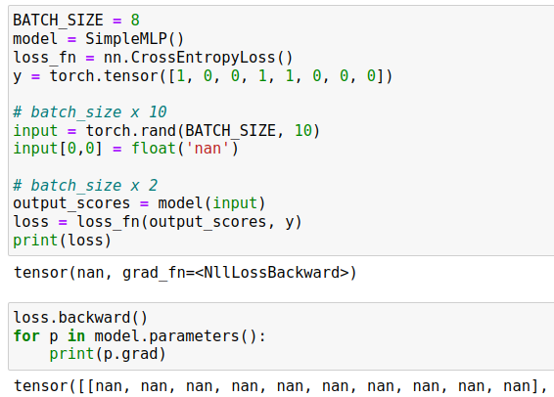
Numerical issues
NaN (not a number) value appears in input data by mistake (missing/corrupted data, preprocessing error etc.)
no errors raised during:
feedforward
loss computation
backpropagation
Notes:
ohter NaN causes: https://stackoverflow.com/questions/33962226/common-causes-of-nans-during-training

Slide 50
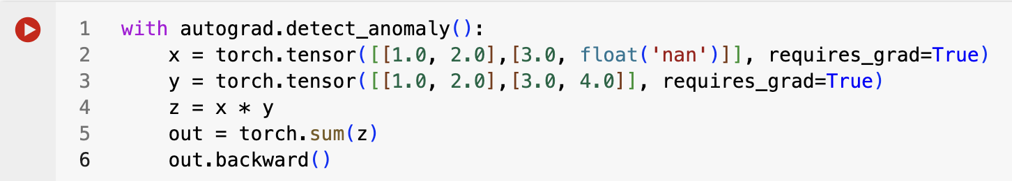
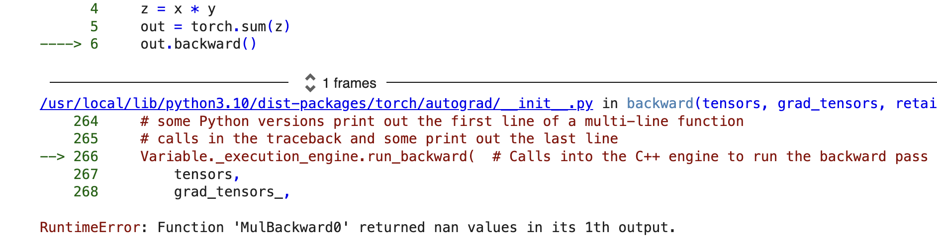
Numerical issues
use torch.isnan(x).any() to manually check tensors
use torch.autograd.detect_anomaly()
Notes:
ohter NaN causes: https://stackoverflow.com/questions/33962226/common-causes-of-nans-during-training

Slide 51
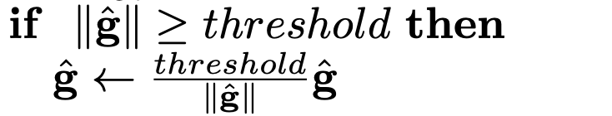
Numerical issues
±Inf (infinity) value shows up in loss or in some intermediate output
possible causes:
learning rate too high => loss blows up
gradient explosions
tips:
decrease learning rate
gradient clipping (rescale gradient if norm > threshold)
Notes:
conv1d

Slide 52
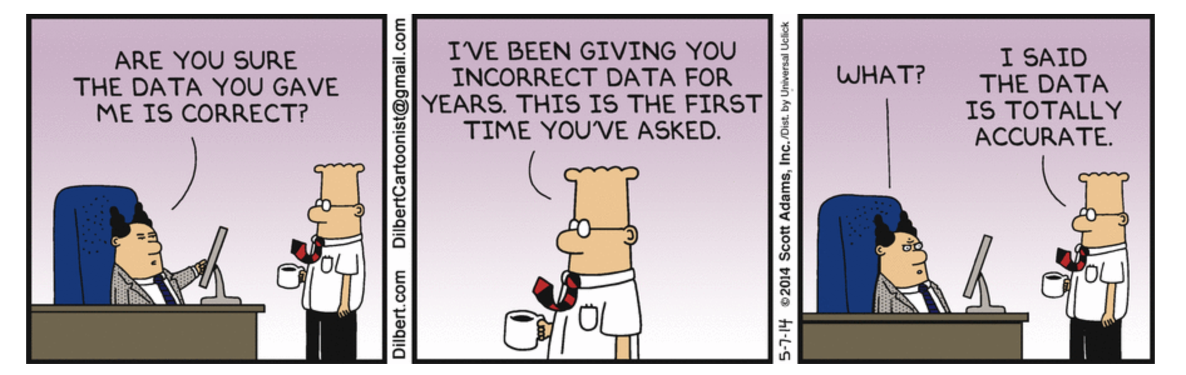
Data issues

Slide 53
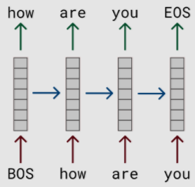
Input issues
in language models, for each input word you have to predict the next word
labels = inputs shifted by one to the left
BOS = beginning of sentence, EOS = end of sentence
Notes:
conv1d

Slide 54
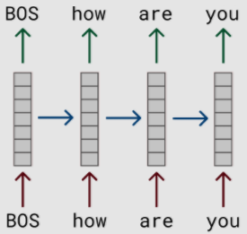
Input issues
in language models, for each input word you have to predict the next word
labels = inputs shifted by one to the left
if labels are not shifted properly, model solves different task by mistake
in this example, model predicts its own input (easy task)
BOS = beginning of sentence, EOS = end of sentence
Notes:
conv1d

Slide 55
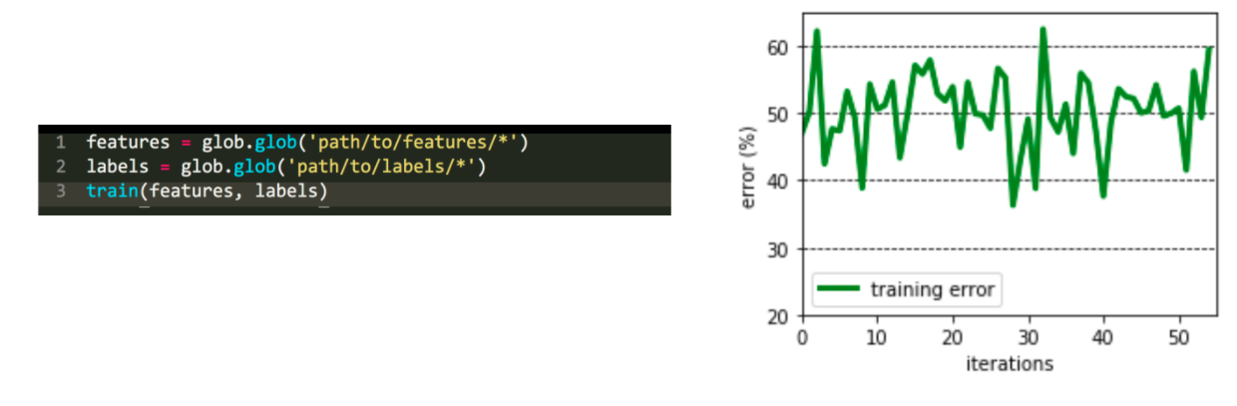
Input issues
examples and labels are read from individual files
what is the issue?
source: https://fullstackdeeplearning.com/spring2021/lecture-7/
Notes:
conv1d

Slide 56
Input issues
examples and labels are read from individual files
what is the issue?
files are read in random order, features[i] and labels[i] are not related
source: https://fullstackdeeplearning.com/spring2021/lecture-7/
Notes:
conv1d

Slide 57
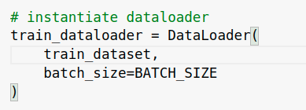
Input issues
what is the issue?
Notes:
conv1d

Slide 58
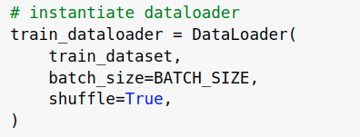
Input issues
what is the issue?
training examples are not shuffled
Notes:
conv1d

Slide 59


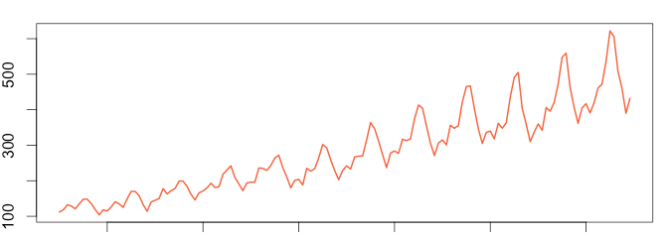
Dataset issues
dataset augmentation commonly improves performance
however, some augmentations are not meaningful and actually hurt model’s performance:
flipping/rotating logos may not improve logo recognition
flipping time series changes trends
Notes:
conv1d

Slide 60
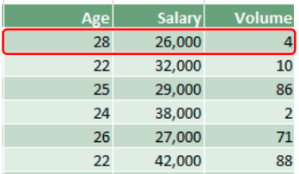
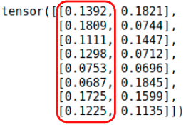


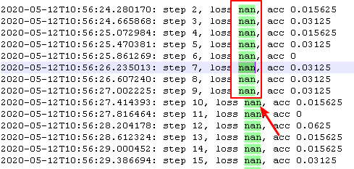

Functional Issues - recap
numerical errors (bad normalization, softmax over the wrong dimension, train/eval model mismatch etc.)
input issues (data not shuffled, out of order labels, input is not fed correctly to model etc.)
cat
dog

Slide 61
Debugging plan
run code and fix syntactic bugs (shape/device/type mismatches, OOM issues)

Slide 62
Debugging plan
run code and fix syntactic bugs (shape/device/type mismatches, OOM issues)
overfit model on a few (1-2) examples
if training loss ~0, start training on full dataset
if not, check for invisible bugs:
manually check input:
lots of zeros or NaN (preprocessing error, corrupted data)
duplicated rows (dataset contains duplicates, augmentation bug)
all batch examples have the same label (no shuffling)
check the arguments:
softmax taken over the correct dimensions
loss function receives the correct output (unnormalized or normalized scores)

Slide 63
Debugging plan
run code and fix syntactic bugs (shape/device/type mismatches, OOM issues)
overfit model on a few (1-2) examples
if training loss ~0, start training on full dataset
if not, check for invisible bugs:
manually check input:
lots of zeros or NaN (preprocessing error, corrupted data)
duplicated rows (dataset contains duplicates, augmentation bug)
all batch examples have the same label (no shuffling)
check the arguments:
softmax taken over the correct dimensions
loss function receives the correct output (unnormalized or normalized scores)
start training on the full dataset
inspect loss/metric learning curves
we may still have invisible bugs at this point! (train data leaks into validation, bug when measuring validation error etc.)

Slide 64
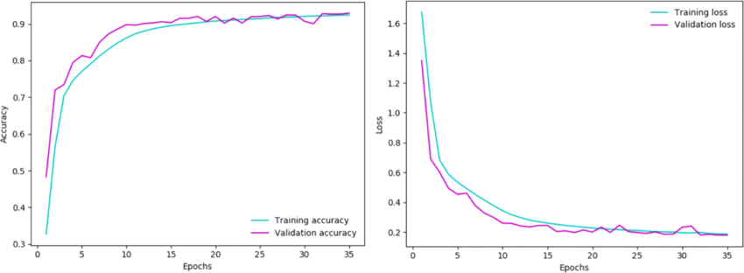
Inspecting learning curves
We plot:
training loss and validation loss curves
training metric and validation metric curves (where metric = accuracy, F1, BLEU etc.)
Based on the shape and values of these learning curves:
we inspect whether the model is training correctly
we choose the best model
source

Slide 65
Learning curves scenarios
training loss increases
training loss stops decreasing
training loss decreases slowly
training loss decreases

Slide 66

Training loss increases
Q: what does it usually indicate?
https://stats.stackexchange.com/questions/364360/how-can-change-in-cost-function-be-positive
Notes:
https://stats.stackexchange.com/questions/352036/what-should-i-do-when-my-neural-network-doesnt-learn/352037#352037

Slide 67
Training loss increases
Q: what does it usually indicate?
A: the learning rate may be too high, moving the parameters away from the local minimum
https://stats.stackexchange.com/questions/364360/how-can-change-in-cost-function-be-positive
Notes:
https://stats.stackexchange.com/questions/352036/what-should-i-do-when-my-neural-network-doesnt-learn/352037#352037

Slide 68
Training loss increases
Q: what does it usually indicate?
A: the learning rate may be too high, moving the parameters away from the local minimum
solution: decrease learning rate
https://stats.stackexchange.com/questions/364360/how-can-change-in-cost-function-be-positive
Notes:
https://stats.stackexchange.com/questions/352036/what-should-i-do-when-my-neural-network-doesnt-learn/352037#352037

Slide 69

Training loss stops decreasing
Q: what could it mean?
training loss
iterations
source: https://jumabek.wordpress.com/2017/03/21/781/

Slide 70
Training loss stops decreasing
Q: what could it mean?
A: it may still indicate a learning rate that is too high
training loss
iterations
source: https://jumabek.wordpress.com/2017/03/21/781/

Slide 71

Training loss stops decreasing
Q: what could it mean?
A: it may still indicate a learning rate that is too high
solution:
start with a smaller learning rate (½-⅓ of original)
training loss
iterations
source: https://jumabek.wordpress.com/2017/03/21/781/

Slide 72
Training loss stops decreasing
Q: what could it mean?
A: it may still indicate a learning rate that is too high
solutions:
if it happens in the early stages of training, start with a smaller learning rate (halve it)
if training loss reaches plateau after a few epochs, use learning rate scheduler (ReduceLROnPlateau - reduces lr when metric stops improving)
training loss
iterations
source: https://jumabek.wordpress.com/2017/03/21/781/

Slide 73

Training loss decreases slowly
Q: what could it mean?
training loss
epochs
source: https://cs231n.github.io/neural-networks-3/

Slide 74
Training loss decreases slowly
Q: what could it mean?
A: it could indicate a learning rate that is too low (loss decreases linearly)
solution: higher learning rate
training loss
epochs
source: https://cs231n.github.io/neural-networks-3/

Slide 75

Shape of training loss curves
the shape of the loss curve provides clue about the learning rate:
loss increases early in the training (very high learning rate)
loss decreases quickly then reaches a plateau (high learning rate)
loss decreases linearly (potentially low learning rate)
however, we care about more than the shape
source: https://cs231n.github.io/neural-networks-3/

Slide 76

Is this a good training curve?
if training loss stabilizes around a value that is still high, the model is underfitting
solutions:
the model is too small to learn the training dataset => increase model capacity (more layers, more neurons per layer)
the model has enough capacity, but:
it is heavily regularized => reduce regularization (smaller Dropout rate, smaller L2 coefficient)
it has a lot of frozen parameters => unfreeze some of them

Slide 77

How to pick a good learning rate range?
let model train and decrease learning rate for each new batch
a good learning rate range:
starts when loss begins to drop steeply
ends when loss slows down, wiggles or starts increasing
source: https://www.jeremyjordan.me/nn-learning-rate/
Notes:
resources: http://www.bdhammel.com/learning-rates/

Slide 78
Learning curves scenarios
we have looked at possible issues with training curves!
training loss increases
training loss stops decreasing
training loss decreases slowly
training loss decreases

Slide 79
Learning curves scenarios
we have looked at possible issues with training curves!
training loss increases
training loss stops decreasing
training loss decreases slowly
training loss decreases, but:
validation loss >> training loss
validation loss ≈ training loss, then diverges
validation loss ≈ training loss
validation loss < training loss
validation loss << training loss
both validation loss and validation accuracy increase
however, a good training curve says nothing about the generalization capability of the model => inspect validation curves!

Slide 80


Validation loss >> training loss
Q: overfitting or underfitting?
source
source
Notes:
other scenarios: https://stackoverflow.com/questions/55444737/validation-loss-much-higher-than-training-loss

Slide 81
Validation loss >> training loss
Q: overfitting or underfitting?
A: model is overfitting
training loss decreases, while validation loss either gets worse or doesn’t improve
model learns patterns that are not useful outside training set
solutions:
add regularization (Dropout/L2)
reduce model size (fewer layers/neurons per layer)
add more training data
source
source
Notes:
other scenarios: https://stackoverflow.com/questions/55444737/validation-loss-much-higher-than-training-loss

Slide 82

Validation loss tracks train loss then diverges
Q: overfitting or underfitting?
source: https://www.youtube.com/watch?v=p3CcfIjycBA

Slide 83
Validation loss tracks train loss then diverges
Q: overfitting or underfitting?
A: overfitting from epoch 100 onwards
validation loss tracks training loss, but diverges from epoch 100
solutions:
early stop at epoch 100
add regularization (Dropout)
source: https://www.youtube.com/watch?v=p3CcfIjycBA

Slide 84

Validation loss ≈ training loss
Q: overfitting or underfitting?
source: https://www.mdpi.com/1424-8220/20/9/2710/htm
Notes:
other good fit: https://machinelearningmastery.com/learning-curves-for-diagnosing-machine-learning-model-performance/

Slide 85
Validation loss ≈ training loss
Q: overfitting or underfitting?
A: good fit
training and validation loss approach 0, with small gap between them
validation loss usually (but now always) slightly higher than training loss
training and validation accuracy also increase simultaneously (they are not always correlated with loss curves)
source: https://www.mdpi.com/1424-8220/20/9/2710/htm
Notes:
other good fit: https://machinelearningmastery.com/learning-curves-for-diagnosing-machine-learning-model-performance/

Slide 86

Validation loss < training loss
Q: validation loss should normally be slightly higher than training loss, why is it lower here?
source: https://www.youtube.com/watch?v=p3CcfIjycBA

Slide 87
Validation loss < training loss
Q: validation loss should normally be slightly higher than training loss, why is it lower here?
A: the model is still a good fit if validation loss slightly lower than training loss
this effect may be due to Dropout, which disables some of the neurons during training
this lowers training performance at the expense of increased generalization during validation (when dropout is disabled)
source: https://www.youtube.com/watch?v=p3CcfIjycBA

Slide 88

Validation loss << training loss
Q: overfitting or underfitting?
source: https://machinelearningmastery.com/learning-curves-for-diagnosing-machine-learning-model-performance/
Notes:
more resources: https://stats.stackexchange.com/questions/187335/validation-error-less-than-training-error

Slide 89
Validation loss << training loss
Q: overfitting or underfitting?
A: neither
validation loss is much lower than training loss, which means the validation set is ‘easier’ for the model than the training set
this may point to potential problems with the validation set:
validation examples easier than training examples (due to some bug in the splitting process or augmenting training examples only)
some training examples leaked into the validation set
source: https://machinelearningmastery.com/learning-curves-for-diagnosing-machine-learning-model-performance/
Notes:
more resources: https://stats.stackexchange.com/questions/187335/validation-error-less-than-training-error

Slide 90


Both validation loss & accuracy increase
Q: lowest validation loss is at ~10k steps, but validation accuracy continues to increase after that, why?
source
Notes:
resources: https://stats.stackexchange.com/questions/282160/how-is-it-possible-that-validation-loss-is-increasing-while-validation-accuracy , https://arxiv.org/pdf/1706.04599.pdf , https://www.reddit.com/r/MachineLearning/comments/si7q6z/d_validation_metrics_improving_despite_validation/

Slide 91
Both validation loss & accuracy increase
Q: lowest validation loss is at ~10k steps, but validation accuracy continues to increase after that, why?
A:
may be less certain when making correct predictions (p=0.9 -> p=0.6 => loss increases from 0.1 to 0.5)
wrong predictions close to threshold 0.5 become correct p=0.48 => p=0.51
labels | 0 | 1
old predictions | 0.1 | 0.9
new predictions | 0.4 | 0.6
better checkpoint
source
Notes:
resources: https://stats.stackexchange.com/questions/282160/how-is-it-possible-that-validation-loss-is-increasing-while-validation-accuracy , https://arxiv.org/pdf/1706.04599.pdf , https://www.reddit.com/r/MachineLearning/comments/si7q6z/d_validation_metrics_improving_despite_validation/

Slide 92
Learning curves TL;DR
validate that the model is training correctly:
train/validation loss curves show a good fit
train/validation loss curves indicate beginning of overfit
choose the best model:
we usually care about the metric on the validation set
apply early stopping at the epoch where validation metric (accuracy/F1/etc.) stops increasing

Slide 93
Debugging plan - recap
run code and fix syntactic bugs (shape/device/type mismatches, OOM issues)
overfit model on a few (1-2) examples
look for incorrect arguments or corrupted data
check data and labels match
start training on the full dataset
inspect loss/metric learning curves
validate model trains ‘correctly’

